Slide 1

MINT – a seed to grow Forth.
SV Fig Saturday 24th May 2025 Ken Boak

Slide 2
“Mighty oaks from tiny acorns grow”
At EuroForth 2018 Ulrich Hoffman and Andrew Read presented a paper : “Forth: A New Synthesis - Progress Report Growing Forth with seedForth” Ulrich came up with the biological analogy suggesting that Forth could be generated organically from a very simple base. This rekindled my interest in “lifting the hood” on Forth, to find out what made it tick. Earlier work by Chuck Moore, Dr. C.H. Ting, Jeff Fox , Bill Meunch and Bernd Paysan had reduced Forth to a few primitives, which could be used to generate a full Forth. Either as eForth, or when used as the basis of the instruction set for a Minimal Instruction Set Computer (MISC), such as the MuP21, P16, F21 and ultimately the Green Arrays F18A. The creation of a thousand forests is contained in one acorn………..

Slide 3

Introduction to MINT
MINT comes from the portmanteau of Minimal INTerpreter.
It is an interpreted, stack-based, integer arithmetic, RPN language.
Like Forth, it uses both a data stack and a return stack.
It uses printable ascii characters as words, variables and primitives.
Many of the symbols and syntax used will be familiar to Forth Users.
There is no dictionary, words are single characters accessed via a jump table.
It provides a subset of Forth - intended for lightweight, resource limited implementation.
The source code is very compact, with good degree of human readability.
Source code text can be cut and pasted with text editor and serial terminal.
MINT is ideal for r microcontrollers and microprocessors lacking in ROM and RAM.
The MINT interpreter occupies typically less than 2k bytes (on Z80).

Slide 4
Implementing MINT
The MINT virtual machine can be readily implemented on almost any CPU.
There are 31 operations which can be accessed using an 8-bit jump table.
Support routines for character, string, decimal and hex number input and output via a serial UART are also needed.
16-bit variables are defined by lower case characters a – z.
User Routines (Colon Definitions) are defined by upper case A-Z characters and use the familiar : ; notation borrowed from Forth.
Memory access is via the familiar FETCH @ and STORE !
Special cases are used for Stack Pointer, Return Stack Pointer, TOS and R.
Arithmetic, logical and shift operations +, - , * , / , &, | , ^, ~, _, { and }
Hex numbers are preceded by #
Stack operations are DUP “, DROP ‘, SWAP $ and OVER %.
The \ character can precede any other character and provide an extended function accessed by an extension jump table.

Slide 5
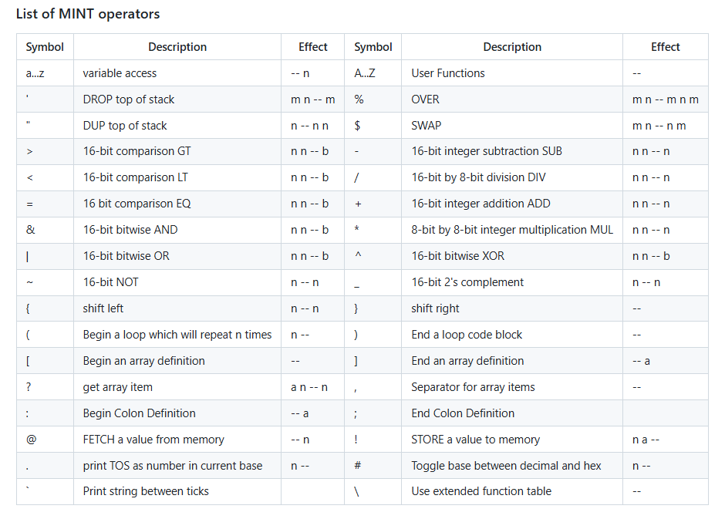

Slide 6
The Evolution of MINT – a little history:- Part 1.
It started with TinyForth by T. Nakagawa in 2004, a cut down Forth, similar in philosophy to TinyBASIC, 26 variables and a reduced word set.
In 2011, Ward Cunningham wrote Txtzyme a tiny interpreter to run on Arduino.
It had just 13 commands, one variable x, no arithmetic, no stacks, no : ; defs.
It provided an immediate, interpreted environment to interact with the I/O.
I came across Txtzyme in 2013, creating SIMPL on Arduino and MSP430.
SIMPL - Serial Interpreted Minimal Programming Language.
This added maths, User Defined functions (colon defs) and more variables.
I used it for exercising motion control systems and force sensor instruments.
I also wrote a simple memory dump screen/editor for MSP430 using SPI RAM.
I called SIMPL a ”hardware bring-up tool” for initial testing of new hardware.

Slide 7

The Evolution of MINT – a little history:- Part 2.
SIMPL was ported to STM32 MCU and other Arduino compatible dev-boards.
Still lacking stacks, it could perform loops, sequences and conditional code.
User (colon) definitions could be chained together to form new functions.
I ported it to MSP430 assembly language, having read of Ting’s eForth model.
SIMPL development was paused due to other work commitments.
In 2019, I began thinking about using SIMPL as “assembly language” for a VM.
I needed to find a simple solution to implementing the missing stacks.
I had watched John Hardy’s presentations on Forth for Z80.
This encouraged me to write SIMPL in Z80 assembly language for my RC2014

Slide 8
The Evolution of MINT – a little history:- Part 3.
In lockdown of Spring 2021, I heard about the STABLE language by Sandor Schneider.
STABLE is a minimal interpreted bytecode language, written in 50 lines of compact C.
Most importantly, this gave me formal implementations for the stacks, in C.
At the same time, John, Sandor and I founded “Minimalist Computing” on Facebook.
John and I discussed an implementation of such an interpreter on the Z80.
John saw MINT as an alternative to assembly language on the TEC-1 computer, a small Z80 machine developed by John in the early 80s for “Talking Electronics” magazine in Australia.
The TEC-1 used a hex-keypad and 7-segment LEDs, limited to just 2K ROM, and 2K RAM.
I worked on the inner interpreter and arithmetic routines, John handled the stack handling and arrays, and Craig Jones provided the new bit-banging serial I/O code.
MINT for Z80 was first demonstrated at Christmas 2021 on both TEC1 and RC2014.
A generic and portable version was written in C by Jason C.J. Tay, hence CMINT. Benchmarks on next slide

Slide 9
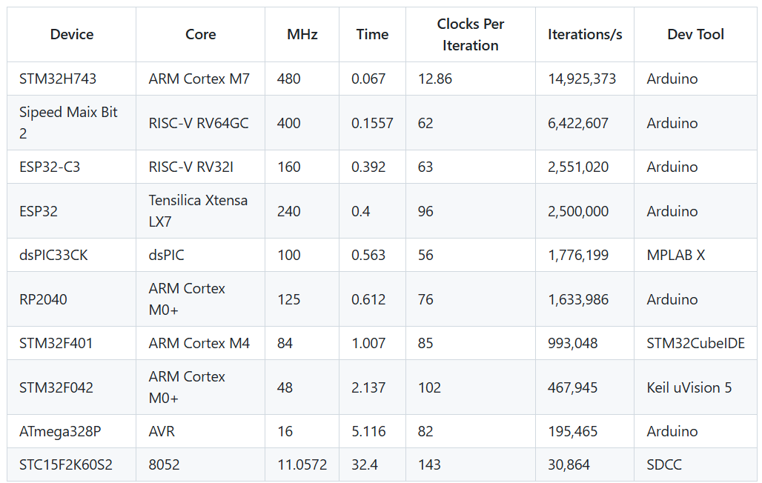
CMINT Benchmarks for 1,000,000 empty loops – Jason C.J. Tay.

Slide 10
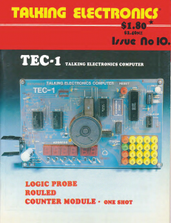

Slide 11
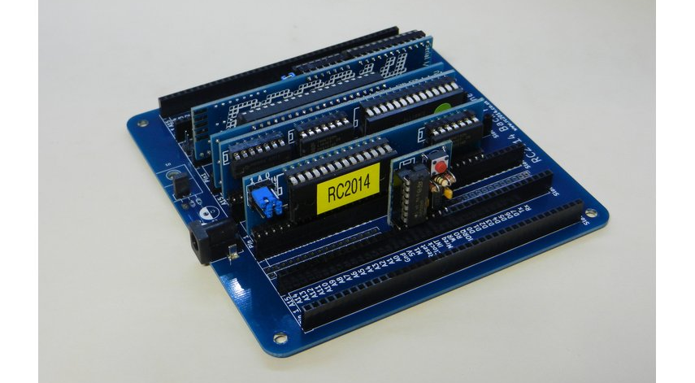

Slide 12
Extending MINT
MINT reserves the \ character as a possible means to extend the language.
The basic MINT code avoids using this character, permitting it to be used as a tag to infer different meaning or syntax - a bit like Chuck Moore’s colorForth.
Using a \ tag would allow longer word names & the use of a dictionary search.
Extending words to 2 characters would allow over 9000 unique definitions.
The \ could be used to code the following ascii characters with bit 7 set.
This coding was often used to provide inverse video on monochrome displays.

Slide 13
Applications and Future Work
MINT has acquired a small, dedicated following within the TEC-1 Community.
John Hardy has written an extended, Z80 version of the language, MINTX.
I am slowly working towards a CPU design in 74HCxx logic or FPGA that executes MINT as its native assembly language. – the “MINT Machine” Inspired by James Bowman’s J1 Forth CPU and C.H. Ting’s eForth.
MINT has a very limited symbol set. Using Python or C++, a cross assembler could be developed to automate the build of MINT for many MCUs.
Python scripts could be used to automate the assembly of MINT, converting a higher level language program to MINT primitives - a MINT scripting tool. Conversely it could be used to decompress/expand MINT to less terse words.

Slide 14


Slide 15
New developments:- eMINT inspired by C.H.Ting’s eForth model.
Ting’s model reduces the Forth inner interpreter to just 31 primitive functions.
These primitives are equivalent to the instruction set of a virtual machine.
A full Forth can be built using these primitives, each written in minimal, target specific assembly language.
I noticed that Ting’s choice of primitives are very similar to those of MINT.
Using the eForth primitives to define MINT, we can use MINT to build a Forth.
But a MINT primitive is defined by 1 character, not a 16-bit jump address.
Thus, an eForth build could be implemented in fewer bytes.
John Hardy had already written some of the more advanced MINT functions using inline MINT code – thus proving the concept.
eMINT could be a compact means to provide portable code for a variety of CPUs
Conceptually, eMINT is eForth’s kid brother.

Slide 16
eMINT – a small seed kernel for Forth
Various attempts have been made to make a small Forth kernel, for example SectorForth and Mini Forth
These were intended to fit into the 510 bytes of a disk bootsector, and then synthesise a full forth from the reduced set of primitives
My inspiration for eMINT came from the MISC (minimal instruction set computer) MuP31, F21 , P16 which Chuck Moore and Dr Ting proposed in the mid-1990s. Further input from Bernd Paysan in 1996.
I decided to code up the eMINT primitives in Z80 assembly language, having studied Dr. Ting’s eForth model.
The 31 eMINT primitives fitted into just 200 bytes of Z80 assembler
On the 6502, the eMINT primitives occupied about 400 bytes
With just 31 primitives, all that was needed was a 5-bit opcode
Like Ting’s P16, Forth Engine, three of the opcodes can be packed into a 16-bit word
I was able to test the primitives in Z80 assembly language on my RC2014, and later on the Agon Light 2 - a fast SBC based on the eZ80

Slide 17
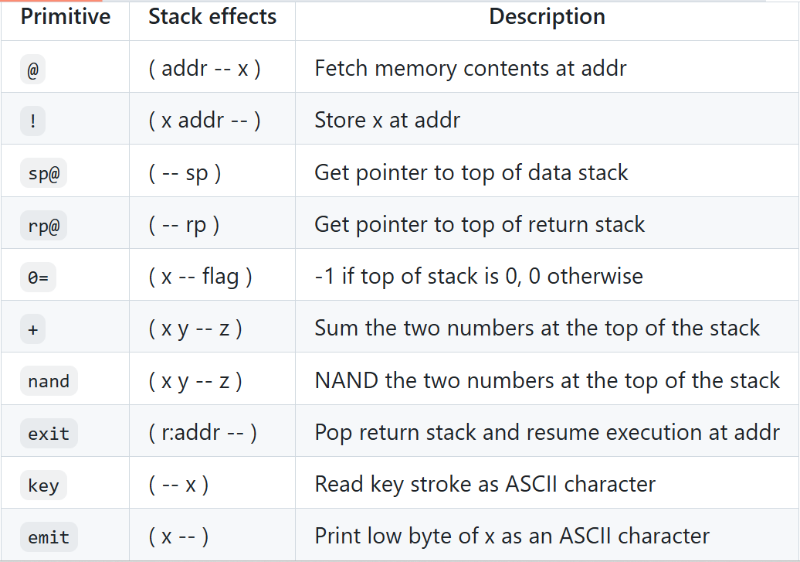
Sector Forth Primitives

Slide 18
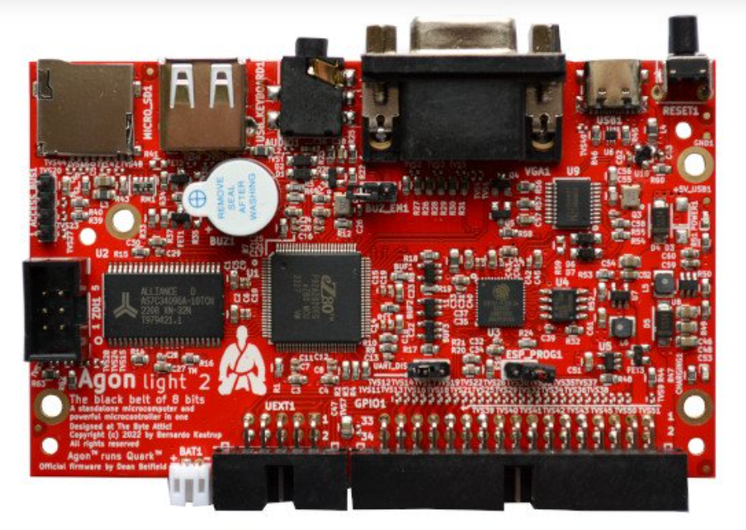
Agon Light - 14 x Faster than a 4MHz Z80
512K SRAM
32GB uSD
VGA video
2 channel audio
Comprehensive I/O
Forth
Z80 assembler
BBC BASIC About 55 USD

Slide 19
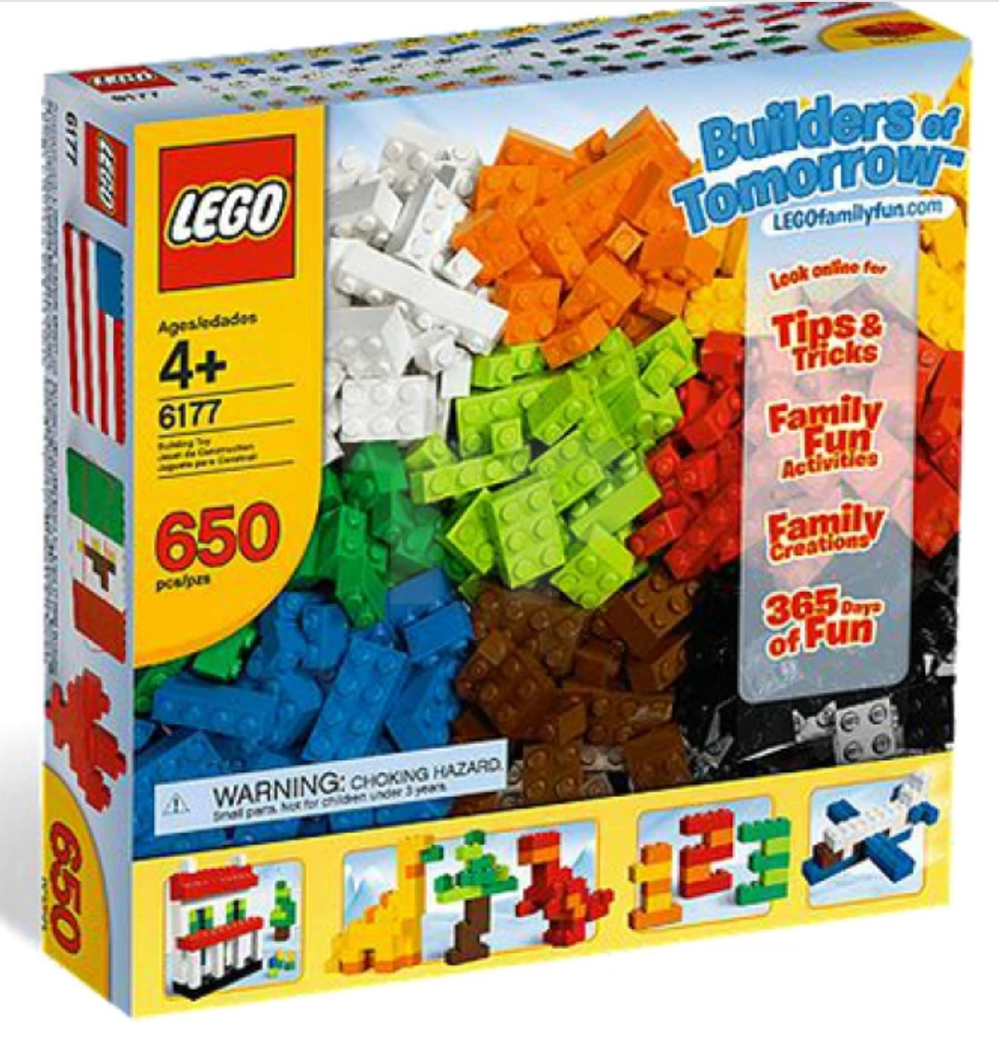
It started with LEGO…….

Slide 20
LEGO provides basic creative building blocks, just like Forth
LEGO, as we know it today was patented in 1958.
LEGO provides a useful analogy for Forth, which also had its beginnings around 1958
Many careers in building, architecture, engineering and computer programming started with LEGO creative play at pre-school age.
Complex systems are assembled from reusable, basic blocks.
The LEGO System means that: all elements fit together, can be used in multiple ways, can be built together. This means that bricks bought years ago will fit perfectly with bricks bought in the future… It means that a LEGO element not only has instant value, but will keep its value always… We will always make sure that all bricks – from yesterday, today and tomorrow – fit together.

Slide 21
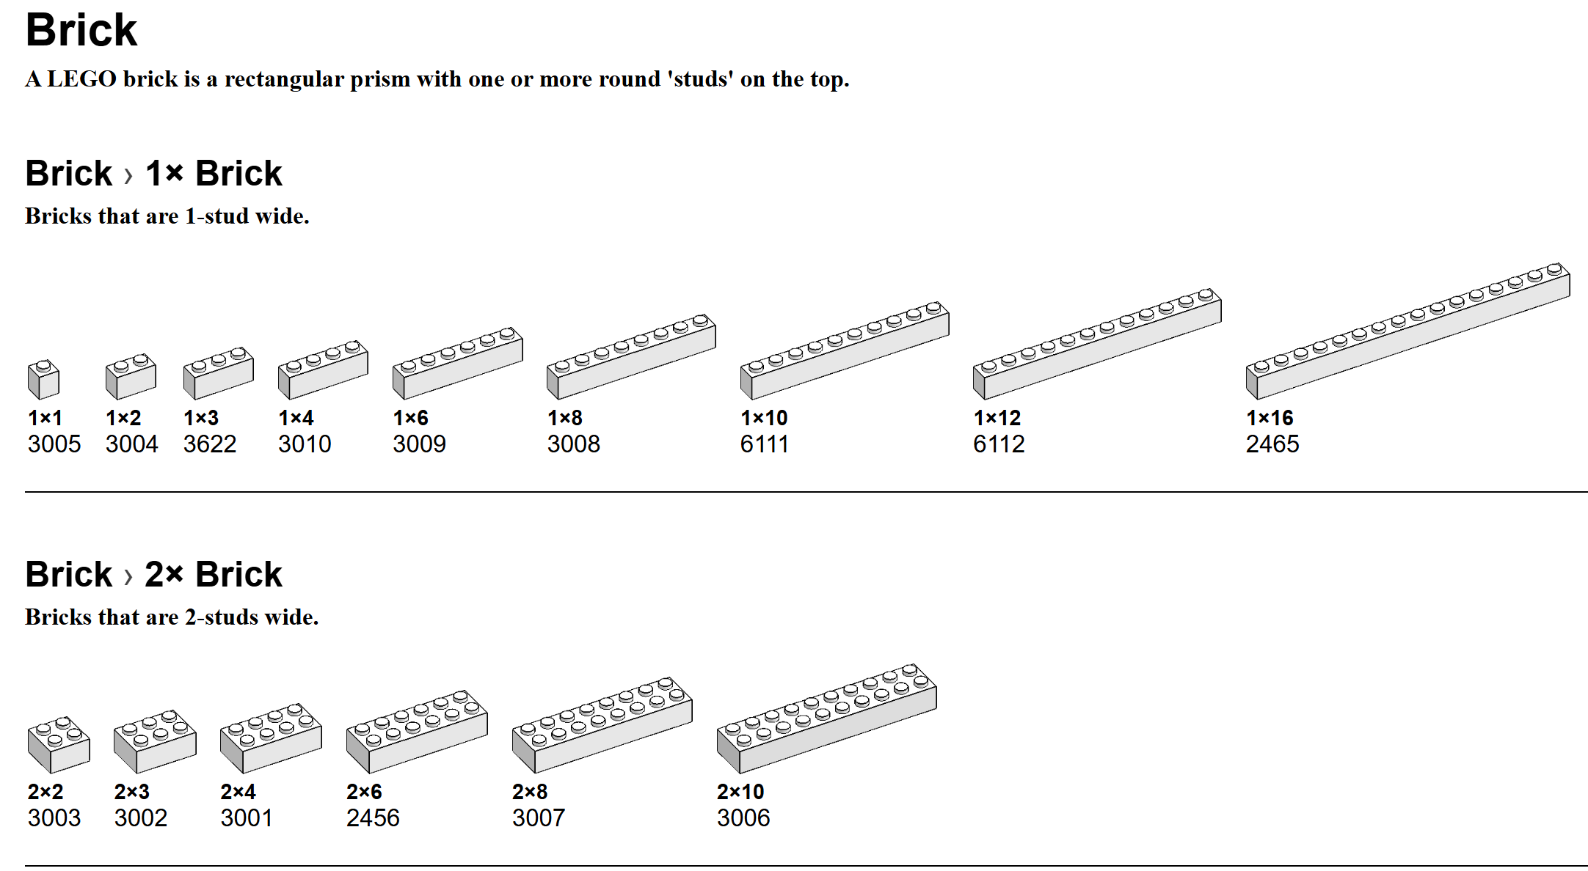

Slide 22
We can think of Forth Primitives as LEGO Bricks
Basic LEGO consists of a few standard bricks and plates, (about 33) which are designed to stack together.
Bricks and plates can be combined to create a sub-assembly of greater complexity. Sub-assemblies can be then replicated, combined and reused.
This is directly analogous to how we use Forth primitives to write code, more complex words are created by assembling primitives together.
It is generally accepted that between 16 and 32 primitives are needed for an efficient Forth. Fewer than this number, whilst achievable, will result in slow (and painful) execution.
Primitives are written in the native assembly language of the processor., creating a virtual machine. These routines have different lengths, very dependent on the ISA of the CPU.
The aim of the MISC, was to reduce each primitive to a single instruction, executing in a single clock cycle.

Slide 23
Future Work - The MINT Machine
A 16-bit Virtual Machine that executes MINT as it’s native assembly code.
Based on C.H. Ting’s P16 with an extended instruction set
MINT instructions based on C.H. Ting’s eForth primitives.
Simulated in about 100 lines of C++ using Arduino IDE, for accessibility.
Intended for implementation in 74xx logic or as a small soft core in FPGA.
Using bit-serial architecture, it could be implemented in as few as 1000 gates and used as a smart SPI controller and other serial applications .

Slide 24
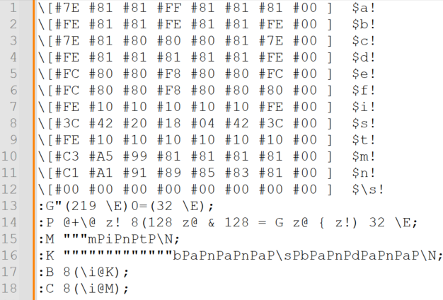
Demo and Questions
675 characters of MINT source code – as used in demo

Slide 25
Links and Resources
Forth – A New Synthesis http://www.euroforth.org/ef18/papers/hoffmann.pdf
eForth C.H. Ting - http://www.exemark.com/FORTH/eForthOverviewv5.pdf
Tytzyme -Ward Cunningham https://github.com/WardCunningham/Txtzyme
TinyForth - T. Nakagawa http://middleriver.chagasi.com/electronics/tforth.html
SIMPL - https://github.com/monsonite/SIMPL
STABLE - https://w3group.de/stable.html
MINT (Z80) - https://github.com/orgMINT
MINT (6502) - https://github.com/agsb/6502.MINT
CMINT - https://github.com/trozodejamon/CMINT
MINT Computing - https://www.facebook.com/groups/278238447530031
Minimalist Computing https://www.facebook.com/groups/minimalistcomputing

